Slide 1
Accel MPU-6050
HYan
2018/12/07

Slide 2
Accel and Gyroscope DEV
MPU-6050

Slide 3
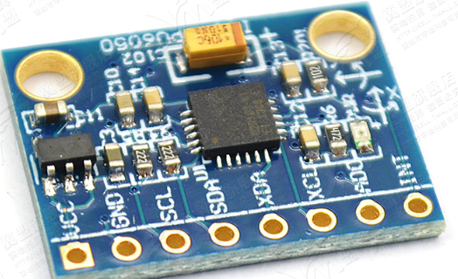
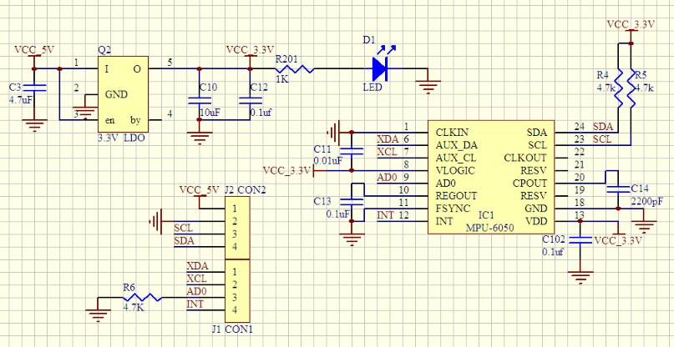
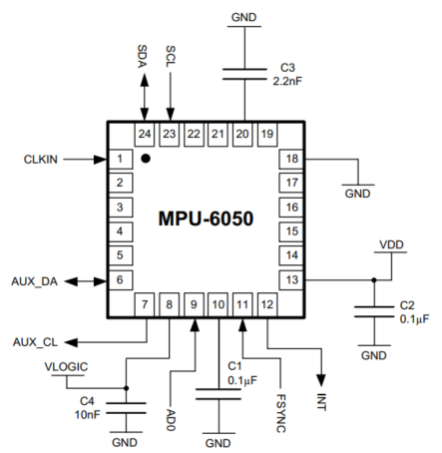
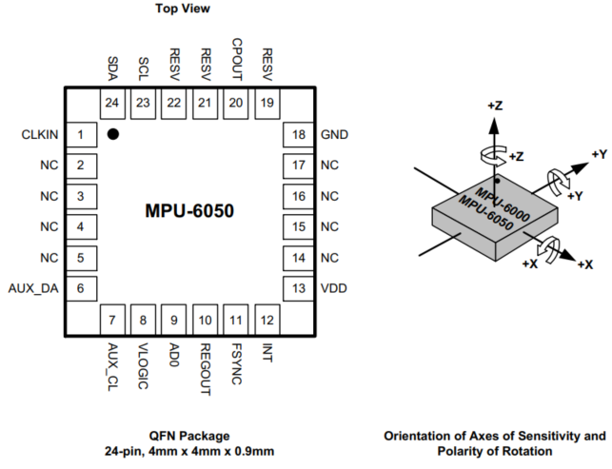
SCH and PCA

Slide 4
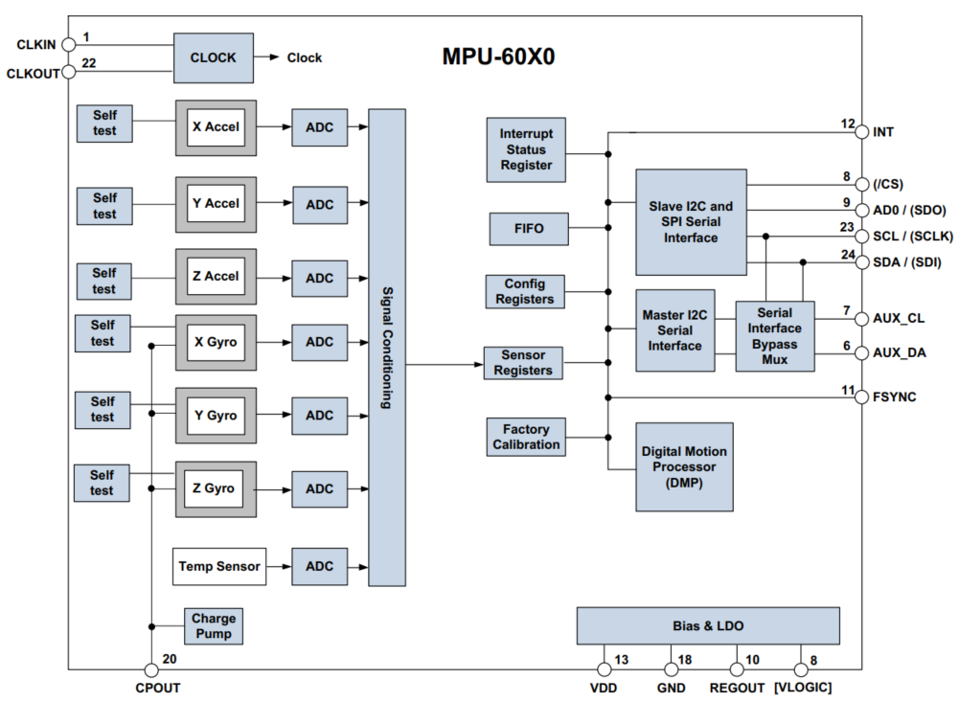
Block Diagram

Slide 5
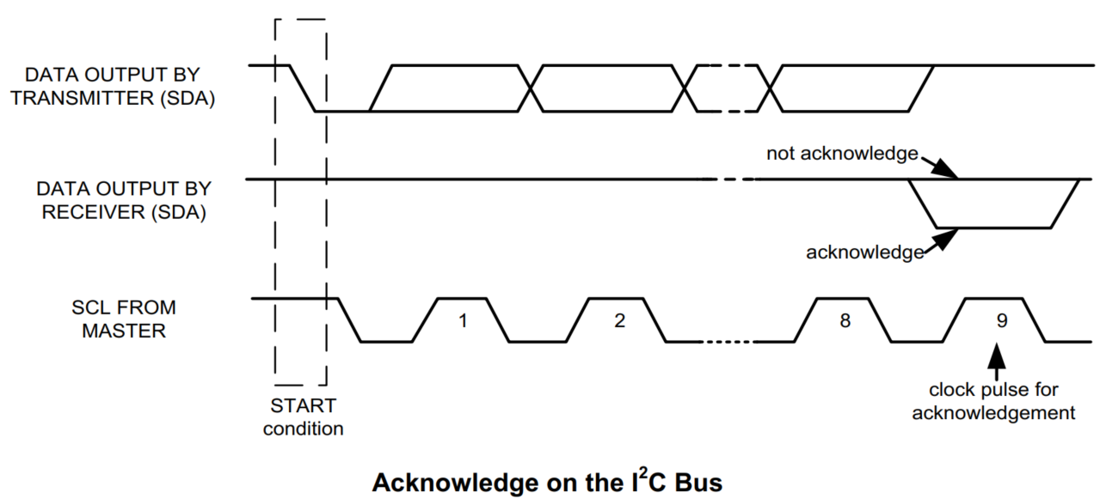
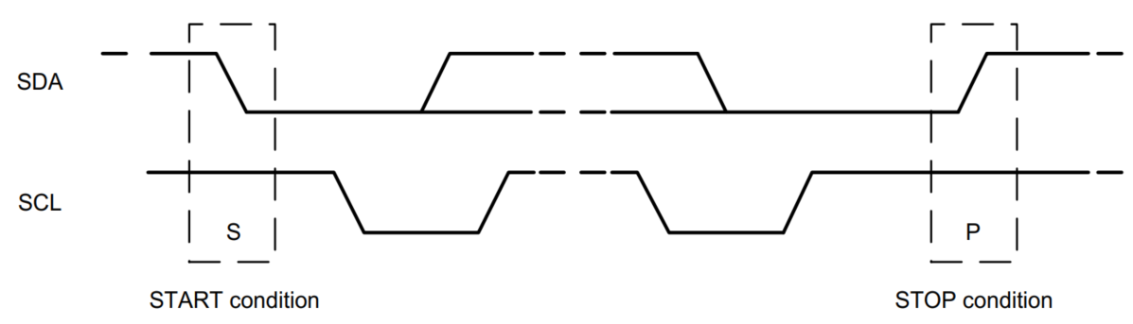
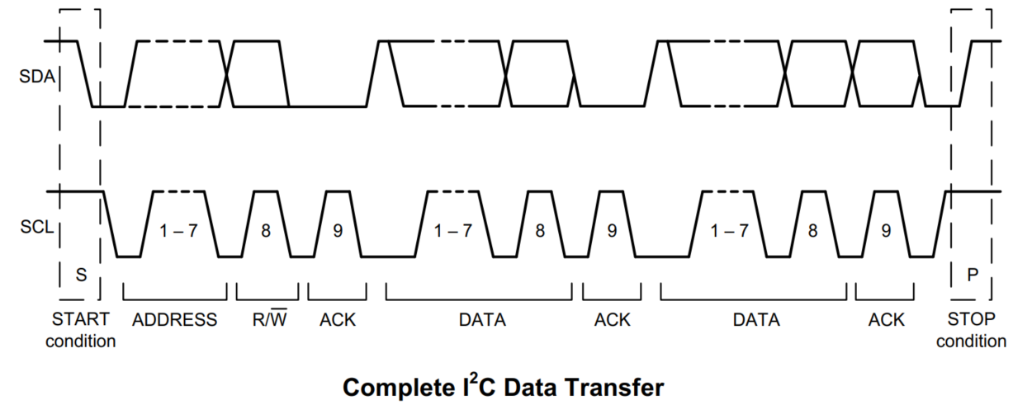
I2C Protocol
Addr: b110100X
b01101000 (pin AD0 is logic low)
b01101001 (pin AD0 is logic high)

Slide 6
Sequence

Slide 7
Block Diagram

Slide 8
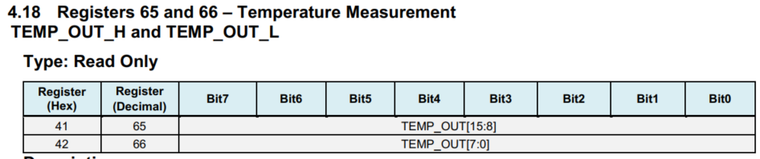
Temperature Cal

Slide 9
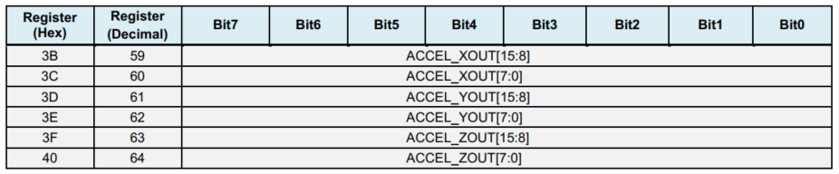
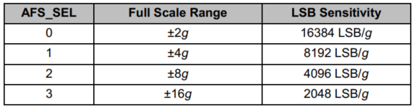
Accel Cal

Slide 10
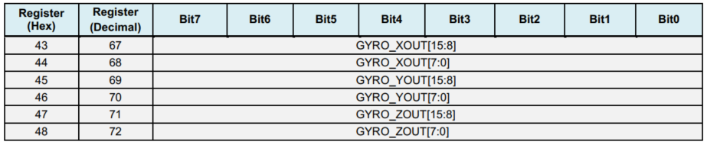
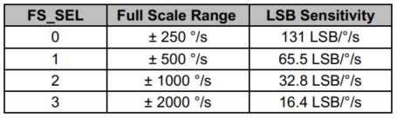
Gyroscope Cal

Slide 11
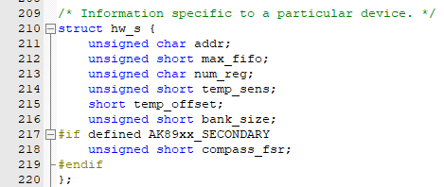
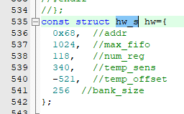
Inv_mpu.c

Slide 12
Conclusion

Slide 13
Version Note
Version 1.0: created on 11/10/2015

